Slide 1
Introduction and Overview
NE 591: Advanced Reactor Materials
Fall 2021
Dr. Benjamin Beeler

Slide 2
Office Hours
Have generated a survey monkey to set a time for office hours
Right now, tentatively set for Wednesday’s 10-11 am, subject to change pending survey results

Slide 3
Syllabus
Course Overview
In this course we will study the basic role of fuel in reactor operation and understand how the fuel impacts heat generation and transport to the coolant. The course will begin with an overview of different fuels and the fabrication processes required to construct nuclear fuel. We will also study various fuel types and geometries, with a focus on light water reactor fuel and cladding. We will then study changes in the fuel and cladding material that degrade the performance of the fuel. Finally, student will apply knowledge gained to conduct fuel performance simulations.
Topical Outline
Advanced Reactor Systems, Advanced Fuel types
TRISO particles
U-Zr (U-Pu-Zr) metallic fuel
Molten salts
U-Mo and U-Si
Advanced Reactor Cladding

Slide 4
Exams, Projects, Grading
Using the standard NCSU +/- grading system, as broken down in the syllabus
Three exams will be conducted open book, timed, and held during normal class hours, with added buffer time – 20% each
Will do problem session lecture prior to exam periods
Project presentations will be via PPT and conducted during normal class hours – 15%
Final project will be via MOOSE, where code will be submitted in addition to a writeup (possibly writeup + presentation) – 25%
No final exam

Slide 5
Feedback
This is a new course, and I want to make sure that this class is able to meet the needs of the students, provides relevant information, and is taught at a level commensurate with the abilities of the students, and I need your feedback to do that
I will be reaching out for feedback periodically throughout the semester
Completion of feedback will gain extra credit on exams

Slide 6

Brief Bio/Background
Computational Nuclear Materials Scientist
Expertise in advanced nuclear fuels
Ph.D. in Nuclear Engineering from Georgia Tech
Previously a staff scientist at Idaho National Laboratory in Fuel Modeling and Simulation Group
Atomistic simulations: density functional theory and molecular dynamics

Slide 7
Advanced reactor systems

Slide 8
What do I mean by advanced reactors?
Several generations of reactors can be distinguished
Generation I reactors were developed in 1950-60s, and are no longer operational
Generation II reactors are the present US and French fleets and most in operation elsewhere

Slide 9
What do I mean by advanced reactors?
Generation III or III+ have been constructed and typically have:
A more standardized design for each type to expedite licensing, reduce capital cost and reduce construction time.
A simpler and more rugged design, making them easier to operate and less vulnerable to operational upsets.
Higher availability and longer operating life – typically 60 years.
Further reduced possibility of core melt accidents
Stronger reinforcement against aircraft impact than earlier designs, to resist radiological release.
Higher burn-up to use fuel more fully and efficiently, and reduce the amount of waste.
Greater use of burnable absorbers ('poisons') to extend fuel life.

Slide 10
Generation III Reactors
The greatest departure from Gen II reactors is the incorporation passive of safety features
Construction is often modular, allowing for offsite manufacturing and onsite assembly
Examples include AP1000, EPR, ABWR

Slide 11
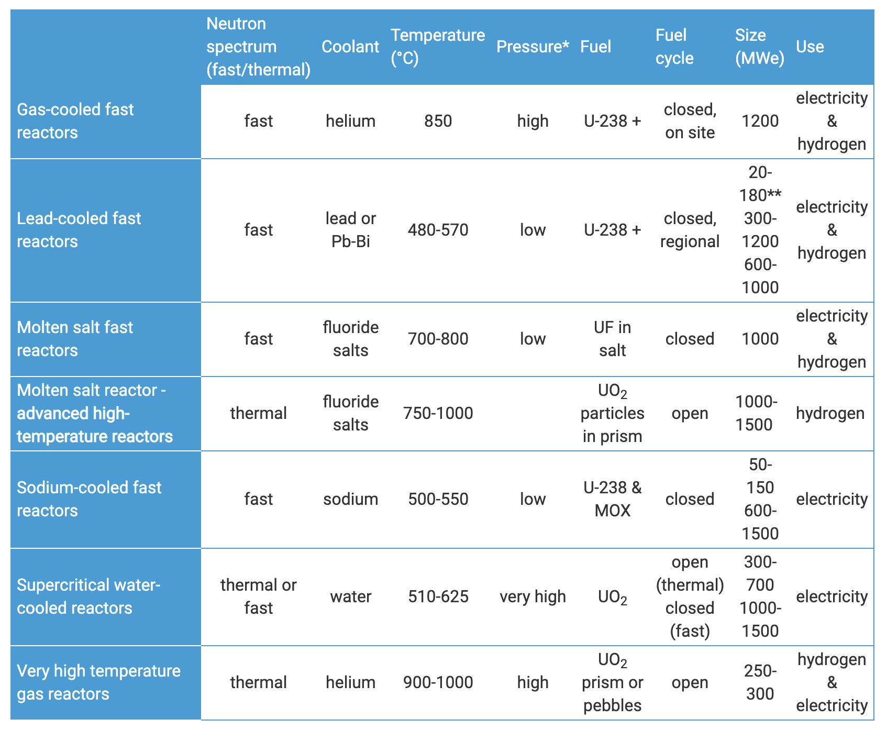
What do I mean by advanced reactors?
Generation IV
designs are still conceptual
typically incorporates six reactor designs
four of these types are fast reactors
all operate at higher temperatures
all six systems represent advances in sustainability, economics, safety, reliability and proliferation-resistance

Slide 12
What do I mean by advanced reactors?
Small Nuclear Reactors
Small Modular Reactors (SMRs)
Micro-Reactors
Reduces the cost associated with building 1000 MW scale reactors, and can provide power away from large grid system
SMRs are 300 MWe or less, designed with modular technology using module factory fabrication, pursuing economies of series production and short construction times
Microreactors (or very small modular reactors vSMRs) are up to 25 MWe

Slide 13
What do I mean by advanced reactors?
Small Nuclear Reactors
Small Modular Reactors (SMRs)
Micro-Reactors
Reduces the cost associated with building 1000 MW scale reactors, and can provide power away from large grid system
SMRs are 300 MWe or less, designed with modular technology using module factory fabrication, pursuing economies of series production and short construction times
Microreactors (or very small modular reactors vSMRs) are up to 25 MWe

Slide 14
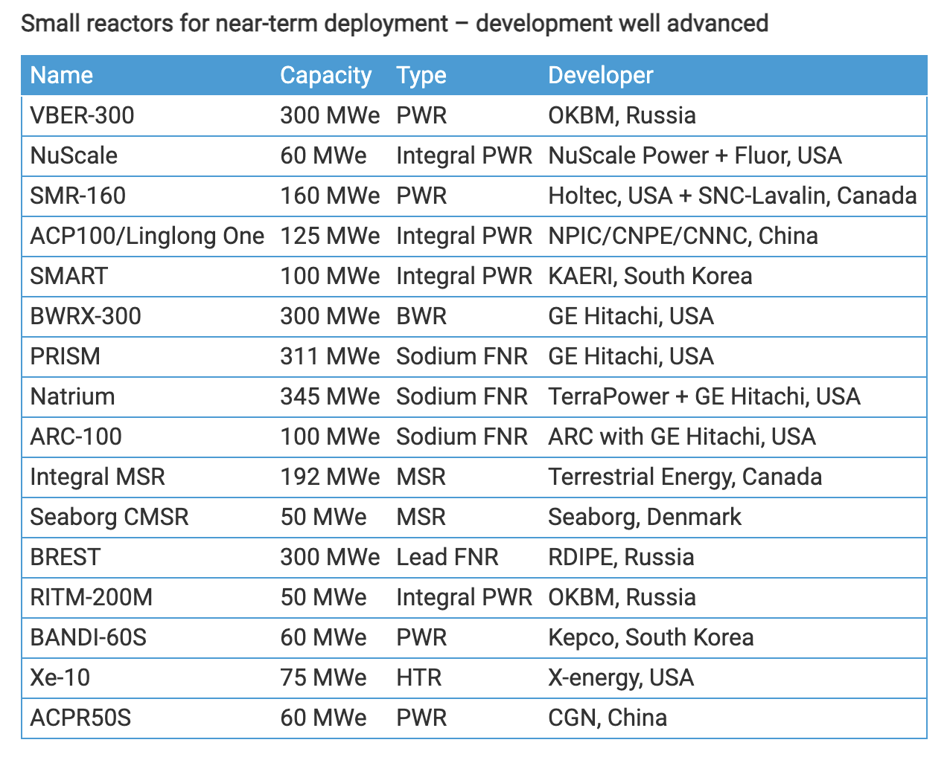
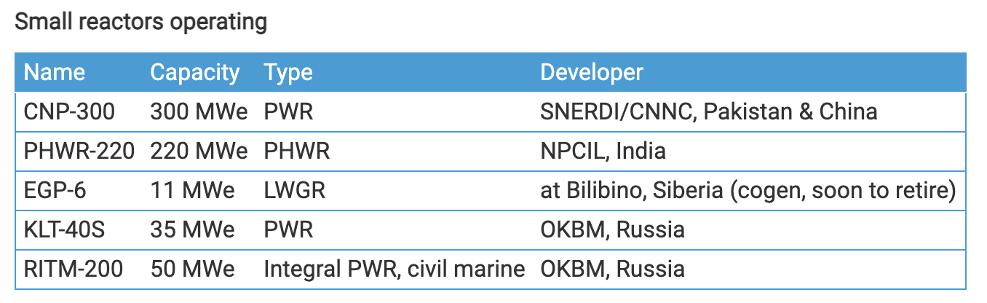
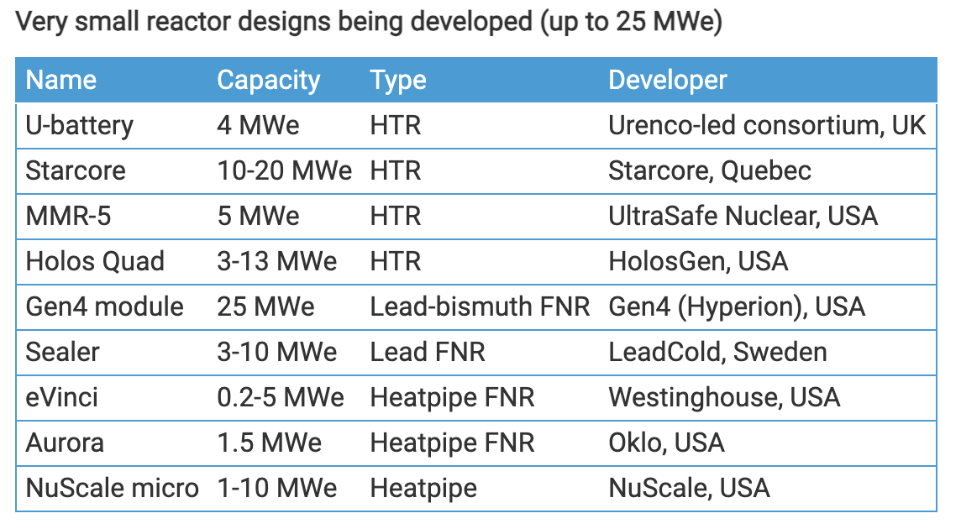
Small Nuclear Reactors

Slide 15
Fuel types

Slide 16
Fuel is the Heat Source
Fuel functions as a heat source, generating heat that is transferred to a coolant, which transfers heat through external loops, heat exchangers, etc., to run a generator

Slide 17
Fuel is limited to select elements
A fissionable nuclide is capable of undergoing fission (even with a low probability) after capturing a high energy neutron
A fissile nuclide is capable of sustaining a nuclear fission chain reaction with neutrons of any energy
A fertile material is a material that, although not itself fissionable, can be converted into a fissile nuclide by neutron absorption and subsequent nuclei conversions.
The Ronen fissile rule states that for a heavy element with 90 ≤ Z ≤ 100, its isotopes with neutrons (A-Z) = 2 × Z – N, where N = 43 ±2 are fissile (with some exceptions)

Slide 18
Potential fuel candidates
The heavy elements with 90 ≤ Z ≤ 100
Thorium (Th), Protactinium (Pa), Uranium (U), Neptunium (Np), Plutonium (Pu), Americium (Am), Curium (Cm), Berkelium (Bk), Californium (Cf), Einsteinium (Es) and Fermium (Fm)
Lets apply the fissile rule to U (2 × Z – N)
(A-Z) = 2 Z – (43 ± 2)
(A-Z) = 2 × 92 – [41, 42, 43, 44, 45] = [143, 142, 141, 140, 139] neutrons
So, U-231 through U-235 should be fissile

Slide 19
There are only four fissile nuclides that are practical for nuclear fuel
U-235
Naturally occurs in uranium in small amounts (0.7%). Can be enriched
Pu-239
Bred from U-238 by neutron capture
Pu-241
Bred from Pu-240 (which comes from Pu-239) by neutron capture
U-233
Bred from Th-232 by neutron capture

Slide 20
Fuel Considerations
Safety:
Stable and predictable behavior
No melting, no phase changes under transients that lead to deleterious behavior
Uranium density
Mechanical integrity
Cladding interactions
Swelling and fission gas release
Operating temperatures

Slide 21
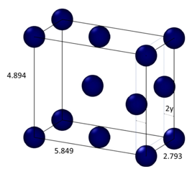
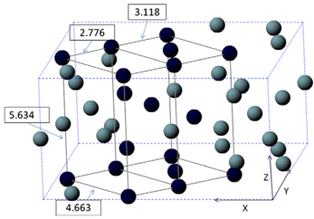
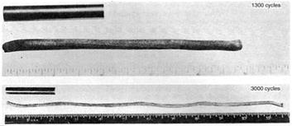
Why not use pure uranium metal?
Pure uranium has three phases
α-phase is orthorhombic
β-phase is tetragonal
γ-phase is body-centered cubic
During thermal cycling, pure uranium dramatically swells
Alpha U has both anisotropic thermal expansion and anisotropic irradiation growth

Slide 22
Fuel Types and Associated Reactor Types
UO2 – Light Water Reactors
Mixed oxide (MOX)
Accident tolerant/Advanced Technology Fuel (ATF)
UZr – Sodium Cooled Fast Reactors
UMo – Research Reactors
UC/UCO – High Temperature Gas Reactors
UN – Lead Cooled Fast Reactors
Other

Slide 23
Uranium Dioxide (UO2)
Reference fuel for nuclear power industry
Single phase, fluorite structure
Fabrication via sintering UO2 powder into pellets
Water coolant
Pellets are stacked inside Zircaloy cladding tubes

Slide 24
Uranium Dioxide (UO2)
Good Characteristics
Very high melting point, about 2800 C
Maintains a stable fluorite phase up to melting
Very compatible with Zircaloy clad (no interaction zones forming/no FCCI)
Relative stability in water
Reasonably radiation resistant
no amorphization
Can incorporate a large number of fission products as substitutional defects

Slide 25
Uranium Dioxide (UO2)
Bad Characteristics
Brittle (thermal stress fractures, fragmentation)
Poor thermal conductivity
Properties very sensitive to stoichiometry
Limited linear heating rates
Non-negligible thermal expansion/swelling
Higher stored thermal energy than other fuel materials

Slide 26
Uranium Dioxide (UO2)
Critical Phenomena
Thermal conductivity (and degradation)
Fission gas release, leading to pressure increase inside the cladding
Fuel fragmentation and relocation under transients
Bambooing creating stress concentrations
All 98 operational reactors in US utilize UO2

Slide 27
Questions?

